Slide 1
NODE.JS
(The Backend Of MERN Stack)
Lecture 9

Slide 2
Today’s Agenda
Local modules
Understanding module object
Using exports property
Using local modules
Exporting Multiple Members
Using exports shortcut
Difference between module.exports and exports

Slide 3
Local modules
Local modules are nothing but those modules which are created by the developer and are not pre-built in Node JS.
They are used to make development life more effortless and fast because they automatically decrease code length.

Slide 4
using a local module
To use a local module we need two steps:
Create and export the module.
Import that module and use it in other files as per requirements

Slide 5
How do we export a module ?
In order to export a module we need to use a special object called module .
Each JS file is recognized by Node.js as a separate module and it gets its module object, which represents the module itself.
Each module's object (also known as a free variable) is unique an includes details such as the filename, path information, exported variables, and more.

Slide 6
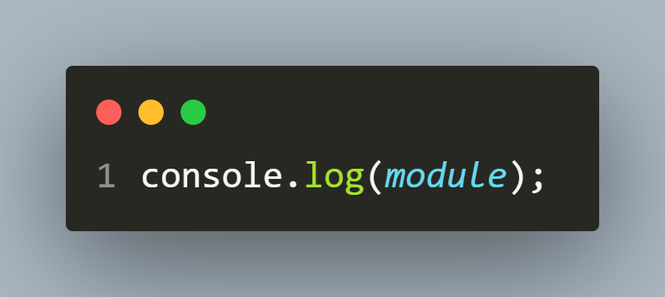
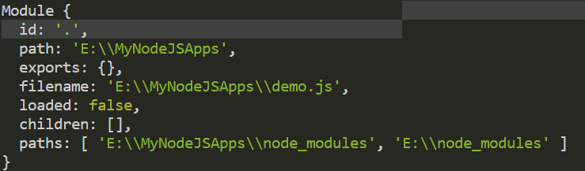
Displaying module object
demo.js
output

Slide 7
The module.exports property
The exports property of the module object is an object in itself.
It contains all of the variables, objects, and functions from our current module that we want to export.
Also, we can add other (current module) objects to it that we want to be available to other files.

Slide 8
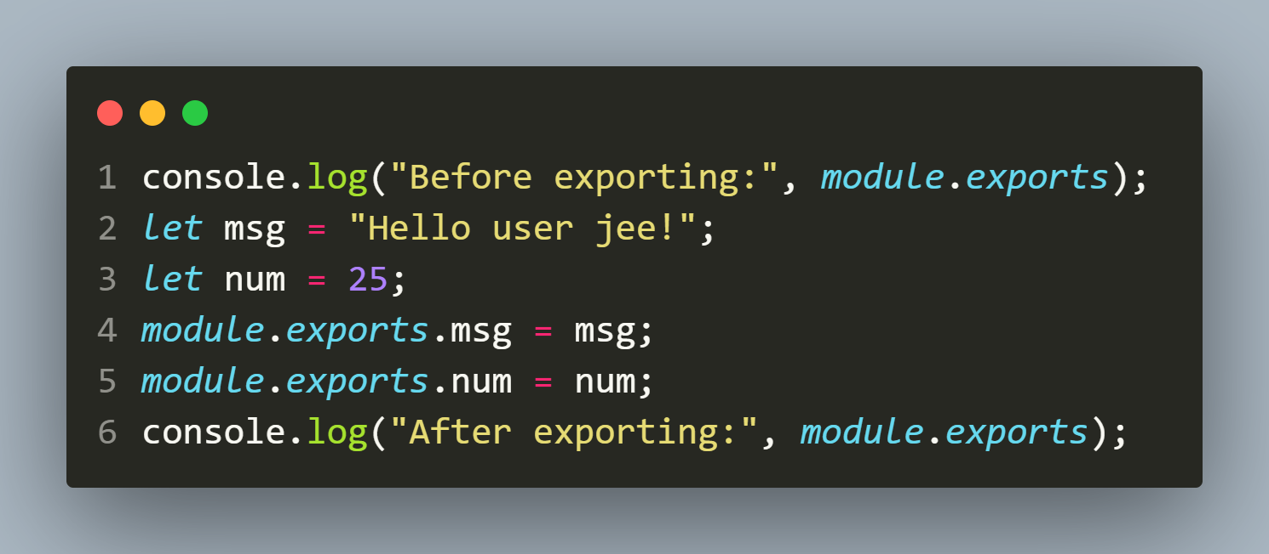
Adding members to module.exports
demo.js
output

Slide 9
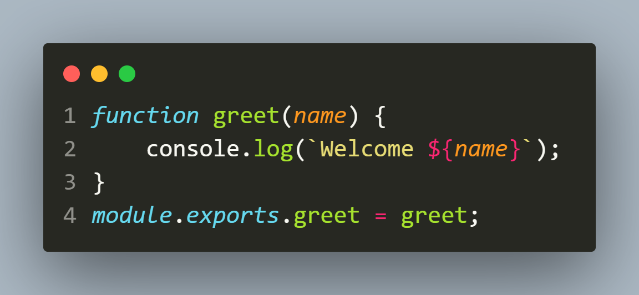
Creating and exporting
welcome.js

Slide 10
Creating and exporting
As you can observe we have created a JS file called welcome.js and defined a function called greet() in it.
We then exported this function by adding it to the exports property of module object.
This will export greet() so that it can be imported to use in other files

Slide 11
Importing a local module
Exporting code using module.exports is only half of the module system.
To use it in another file , we need to import it which is done using the function require()

Slide 12
Importing a local module
Syntax:
const var_name= require(“./name of module”);
In order to load a local module, we pass its relative file path to the require() function, which returns the value of module.exports from the file.
Example:
const welcome=require(“./welcome.js”)

Slide 13
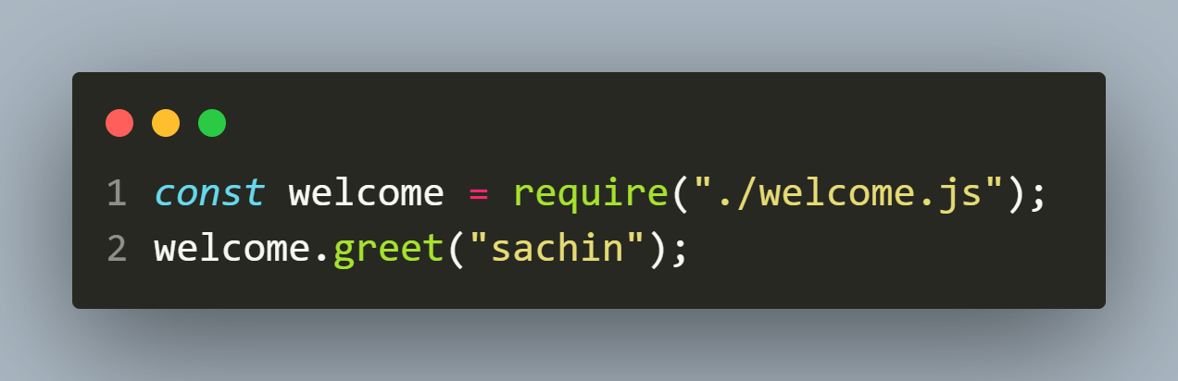
Importing a local module
main.js

Slide 14
Full coDe
welcome.js
main.js

Slide 15
Exporting multiple members
Just like we can export one function , we also can export other functions and variables or arrays .
To do this we can take either of 2 approaches:
Add them individually to module.exports
Add them to module.exports as an object.
Then in the second module while importing them either we can load the entire module by passing the file name to require() or we also can import individual member.

Slide 16
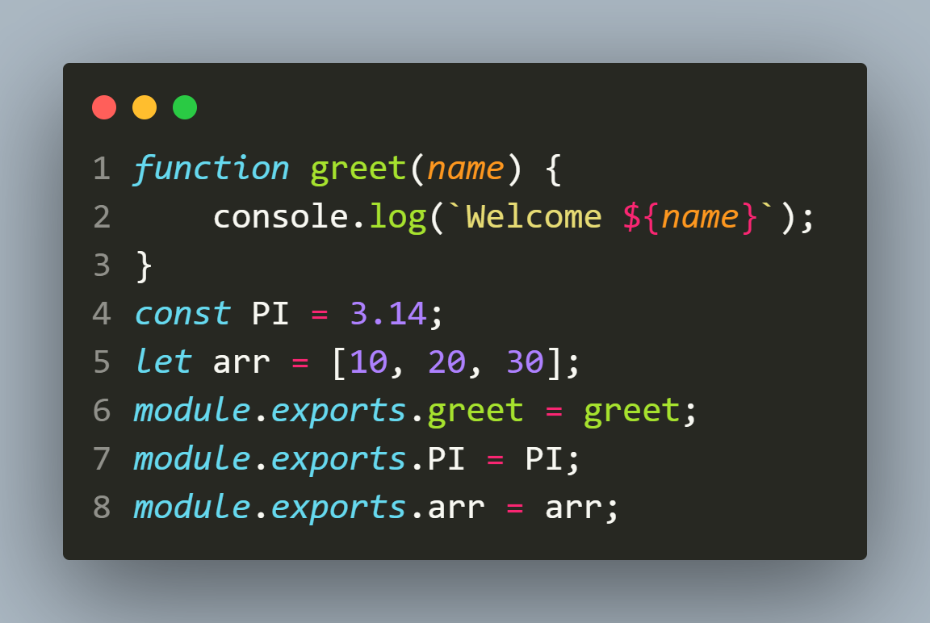
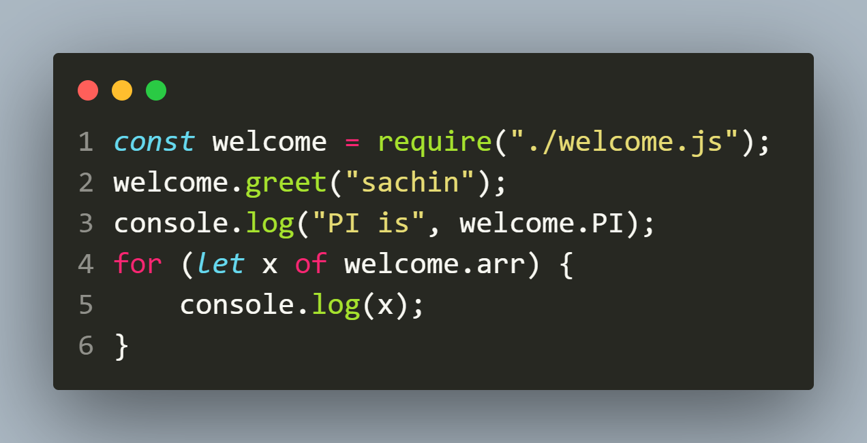
first way
welcome.js
main.js

Slide 17
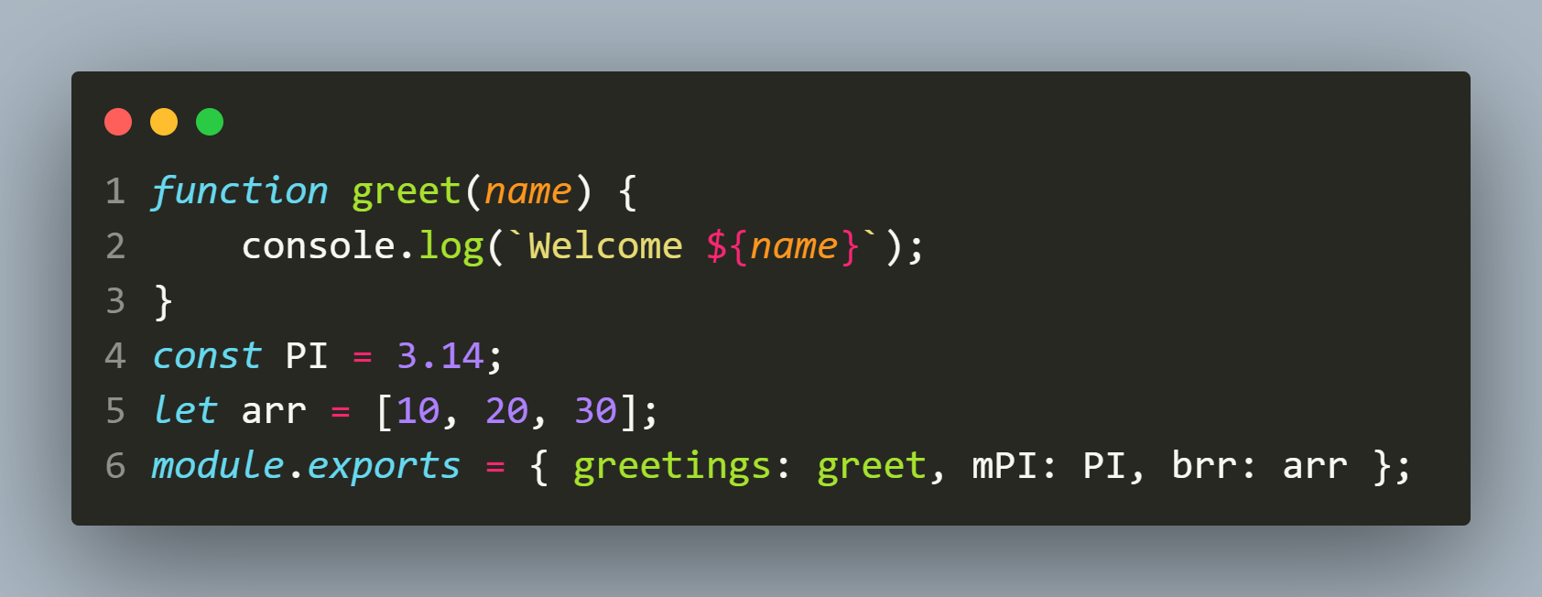
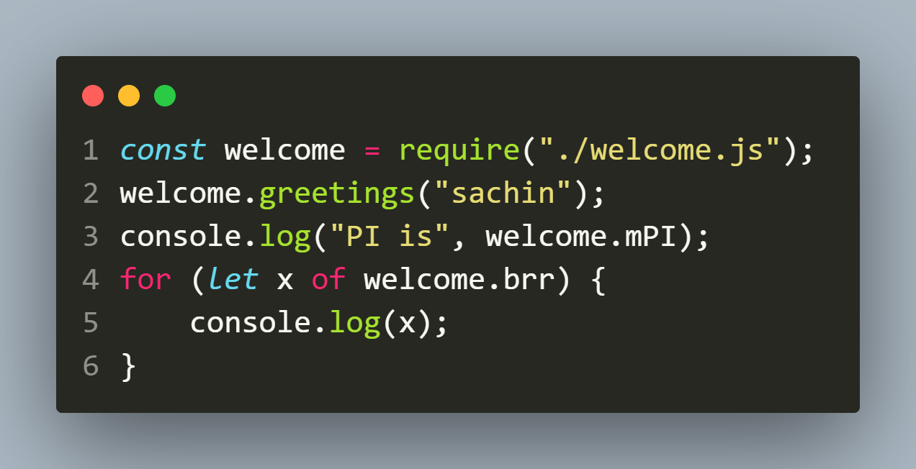
Second way
welcome.js
main.js

Slide 18
Important point
If we want to export the module members with the same name as they have been defined then we can simply assign their names to module.exports as initializers .
The code to import and use them will remain same as before

Slide 19
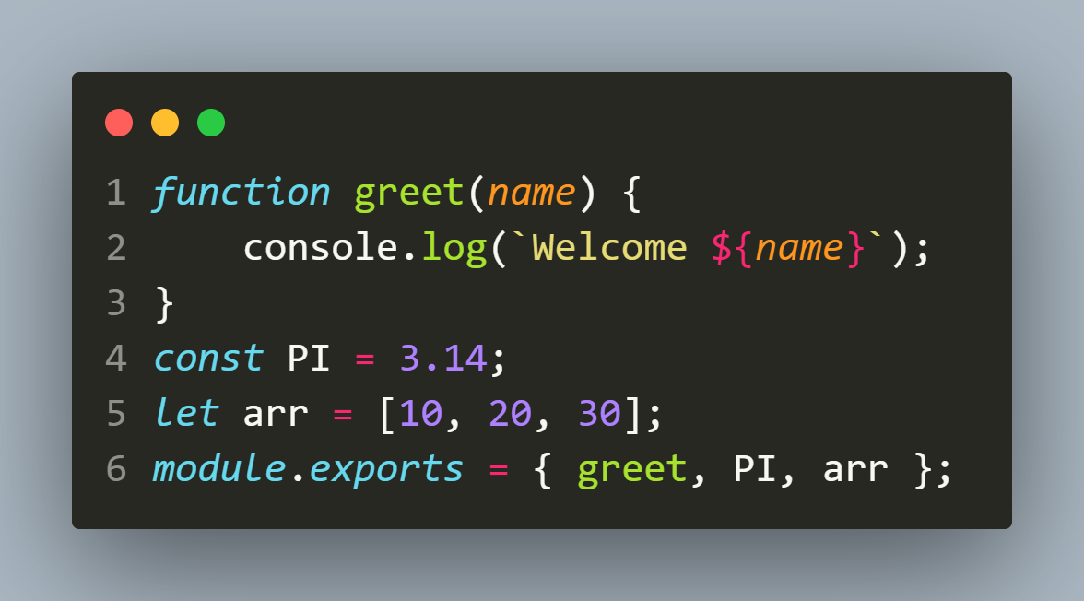
Important point
welcome.js
main.js

Slide 20
Importing only specific property
Till now we imported the whole module , but Node allows us to import only specific members .
We can do this in 2 ways :
Using JavaScript’s destructuring feature
Using . operator

Slide 21
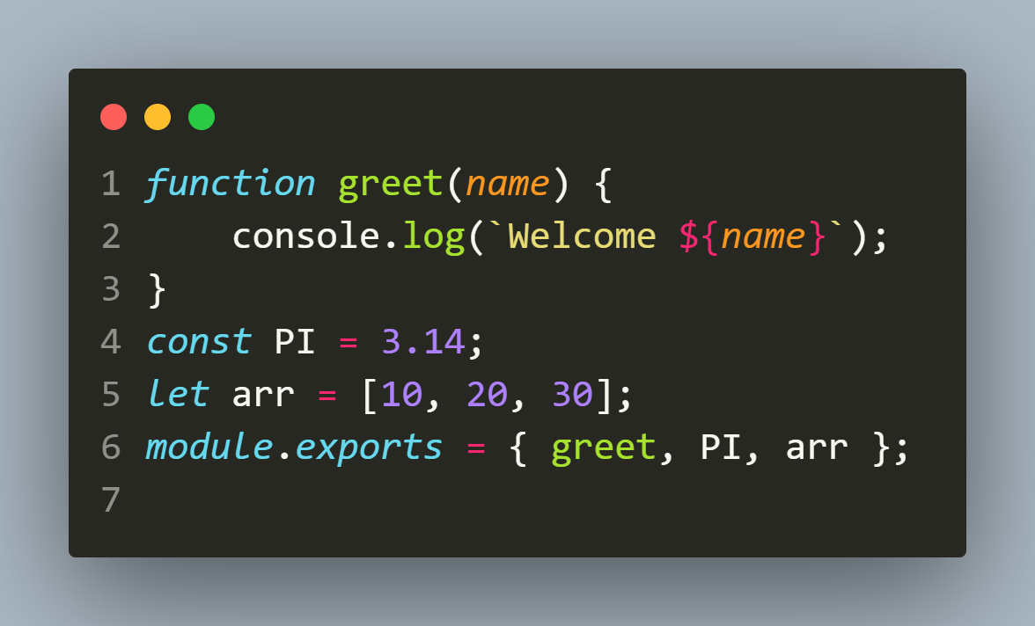
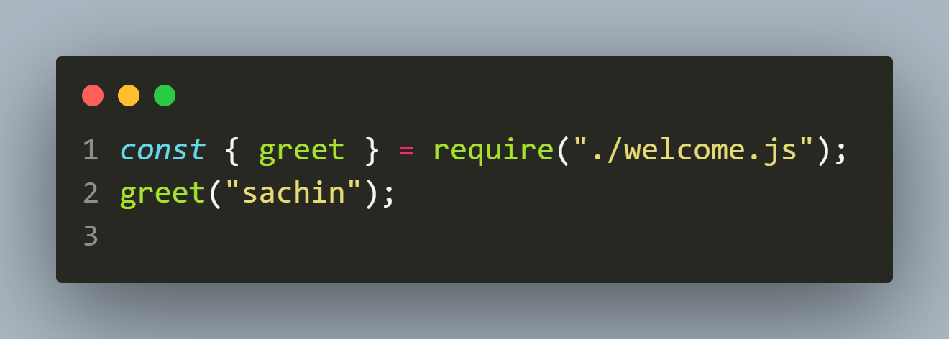
Using destructuring
welcome.js
main.js

Slide 22
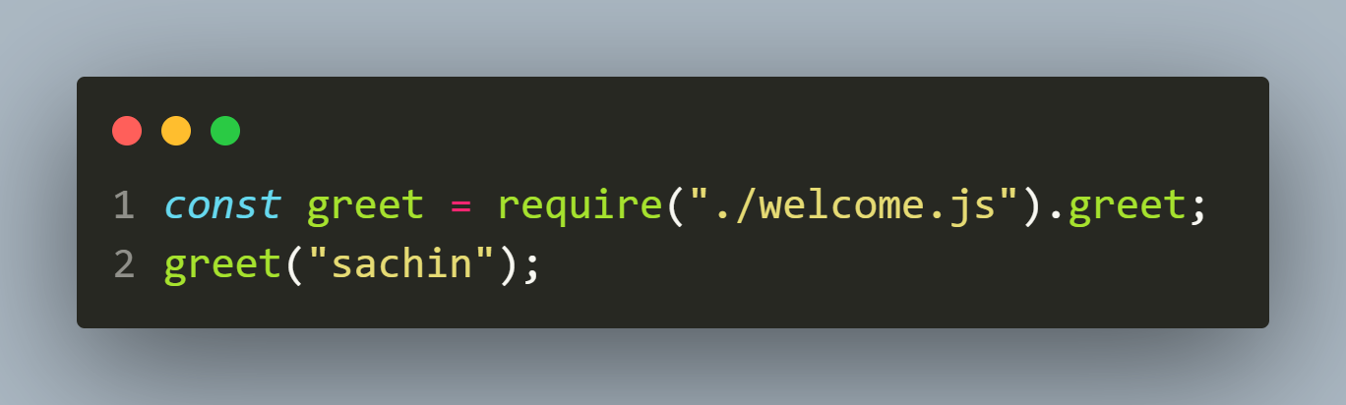
Using .operator
welcome.js
main.js

Slide 23
Exporting default value
In the previous examples , we’re exporting functions and values individually.
This is handy for helper functions that could be needed all over an app.
But when you have a module that exports just the one thing, it’s more common to directly assign it to module.exports

Slide 24
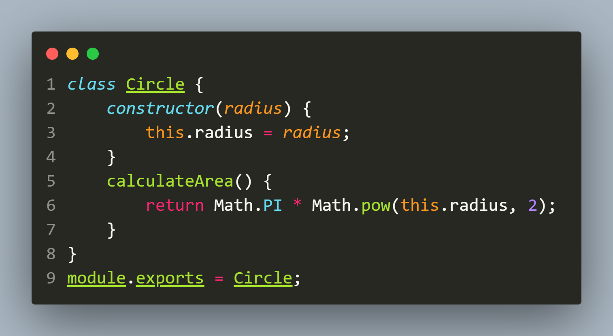
Exporting default value
figure.js
The above code will now export the class Circle as default export and now we can import and use it directly using require() , without prefixing it with the module name

Slide 25
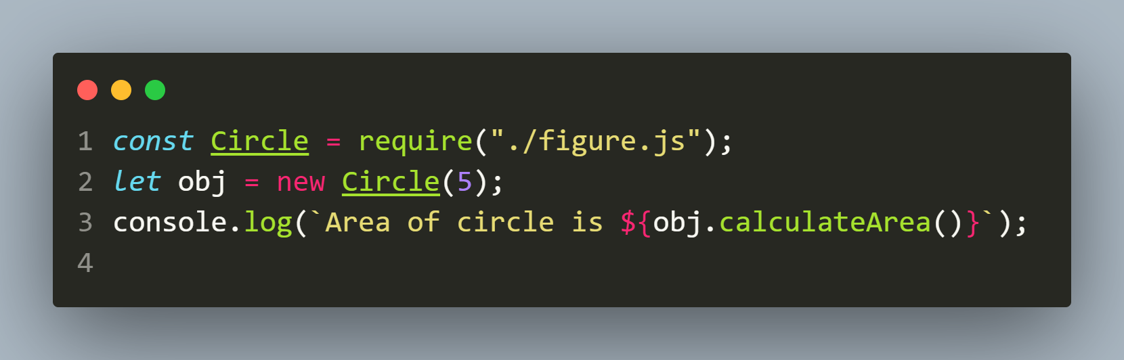
Exporting default value
main.js

Slide 26
Using exports
Node js provides us a shortcut to module.exports and it is called exports.
It is a keyword that acts as a reference to module. exports and is a quick way to export values from a module.
All it does is populate the module.exports object.

Slide 27
Using exports

Slide 28
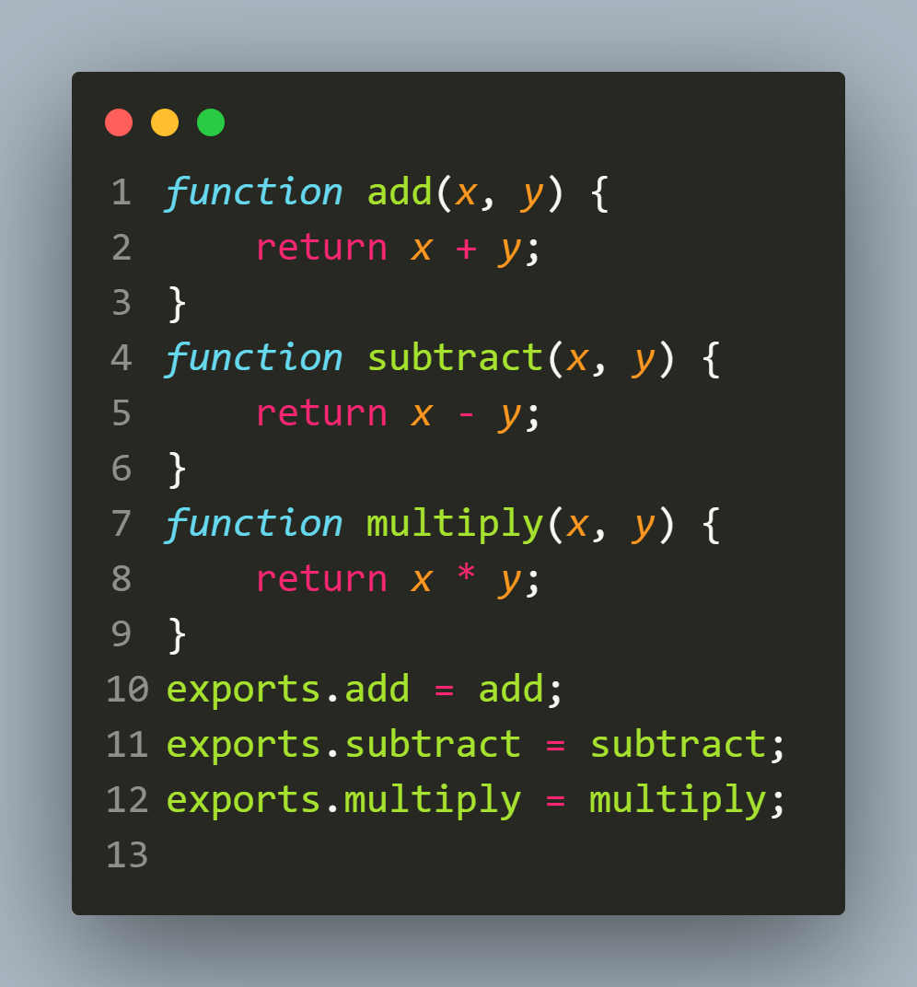
Using exports
math.js

Slide 29
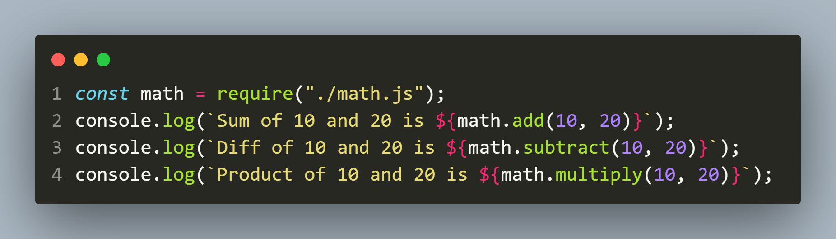
Using exports
main.js

Slide 30
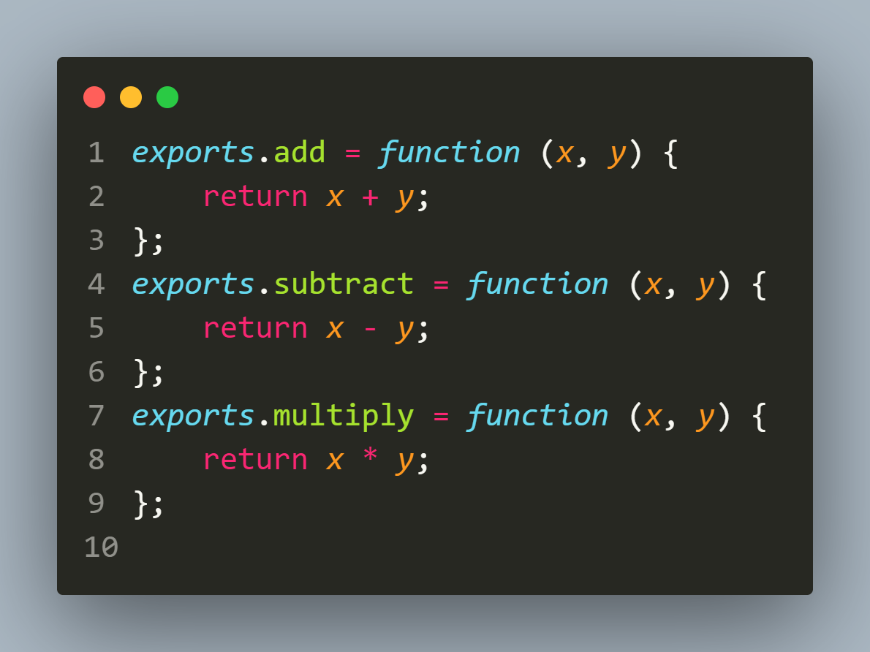
Using exports ON THE FLY
math.js

Slide 31
Using exports ON THE FLY
main.js

Slide 32
module.exports v/s exports ?
After learning about exports we might think about a question why use module.exports when exports seems to achieve the same result with fewer keystrokes?
To answer that, let's take a look at the code segments given in next two slides

Slide 33
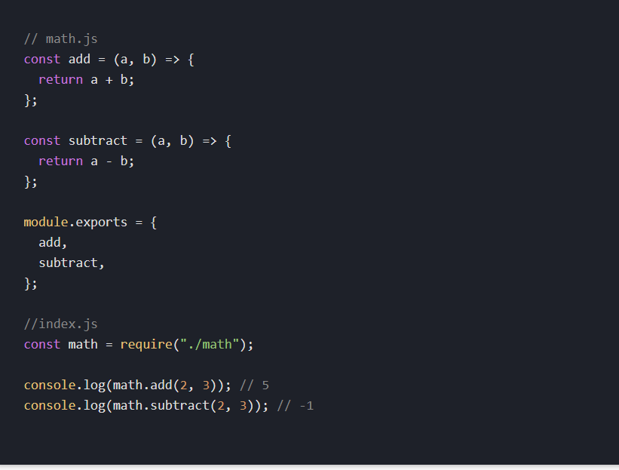
Assigning object to module.exports

Slide 34
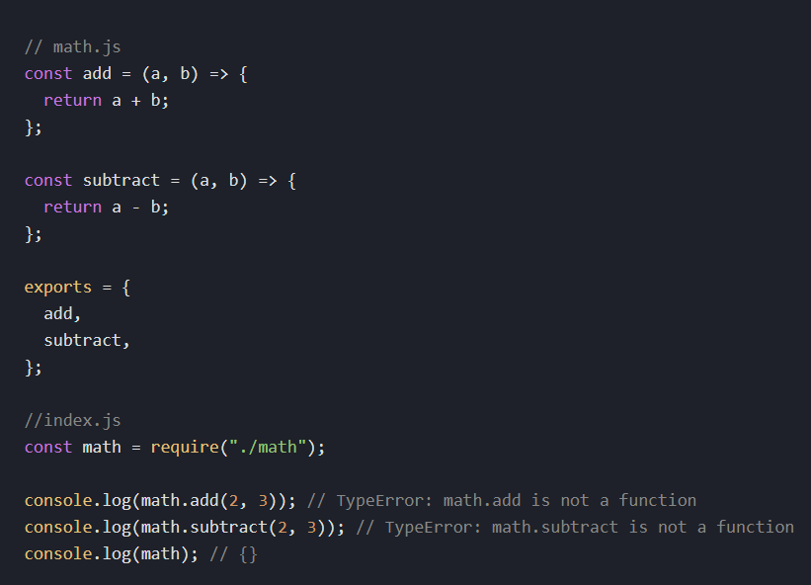
Assigning object to exports

Slide 35
WHY THE PREVIOUS CODE FAILED ?
In Node.js environment module is a plain JavaScript object with an exports property.
On the other hand exports is a plain JavaScript variable that happens to be set to module.exports.
When we use require() for a module in another file, then only module.exports is returned.

Slide 36
WHY THE PREVIOUS CODE FAILED ?
Now, if we assign a new object to exports, the reference is broken and updating exports no longer updates module.exports.
Thus if we try to access the functions add() or subtract() on the exported object, an error is thrown because module.exports is empty.

